Slide 1
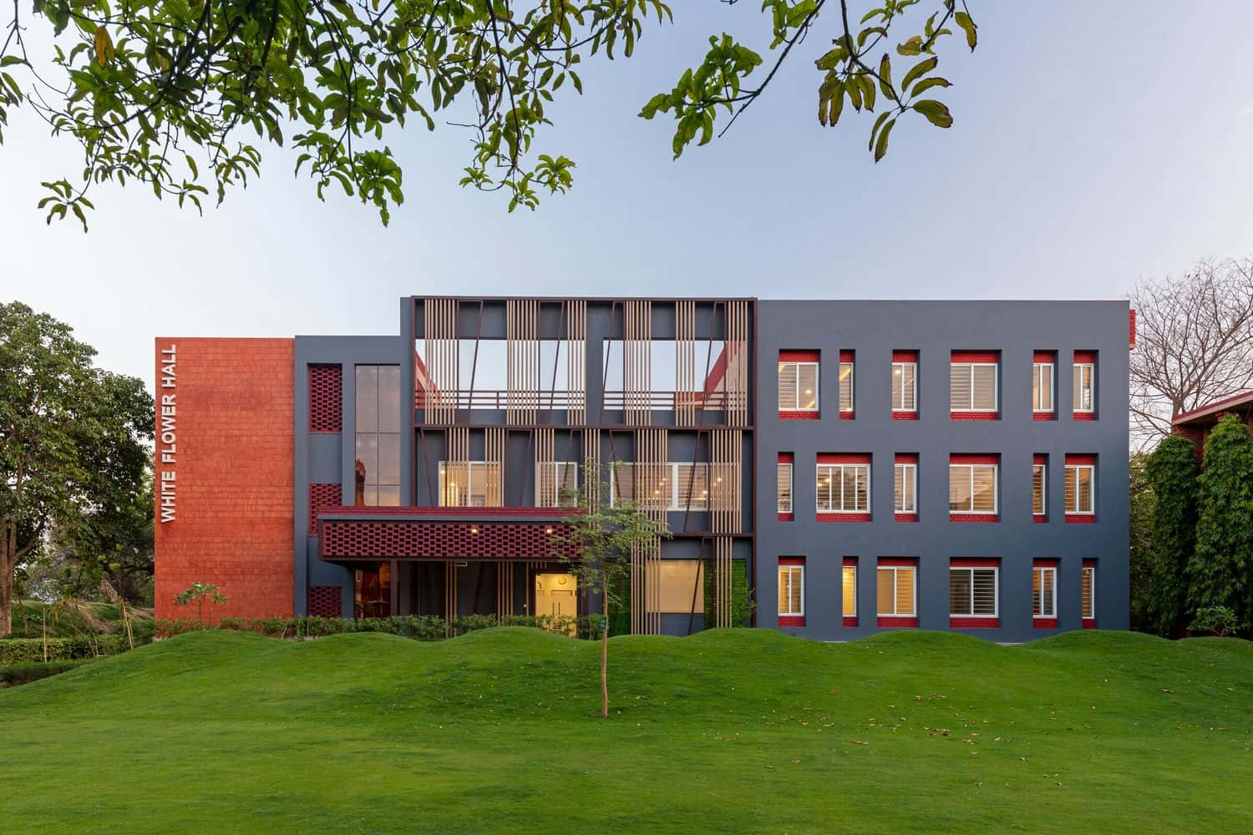







Super hostel Management System

Slide 2



Farhana Lucky
Instructor
ID: 1272486
WDPF
ROUND: 54
Submitted to
Mohammad Moshaidul Islam
Consultant
IDB BISEW
Sheikh Rownakul Islam Miraj
Student
ID: 1272486
ROUND: 54

Slide 3
Index
INDEX OF PROJECT | Slide No.
Proposal Application | 4
Introduction | 5
Objectives | 6
Benefits | 7
Software Features | 8
Entity Relationship Diagram | 9
Software Flowchart | 10
Modules | 11
Timeline and Milestone | 12
Technical Information Source | 13
Use of Tools and Technologies | 14
Roles | 15
Methodology | 17
Example of Invoice Reports | 18
Forms Samples | 20
Conclusion | 22

Slide 4
Application
4th September, 2023
The Consultant
IDB Bhaban,
Sher e Bangla, Nagar, Dhaka
Subject: Project proposal letter for the Super Hostel Management system.
Dear sir,
Thank you for offering us a great opportunity to make a real life project based on our core course that is Web Development with PHP and Framework(WDPF). In this project, I would like to inform you that We have decided to make a project on Super Hostel Management System, which is most important for every superhostel owner. I have studied about the various aspects of the system and make a proposal accordingly which is enclosed here with for your kind perusal. So, We think you will finally Approved the project and help to utilize our creativity.
Sincerely,
Name: Sheikh Rownakul Islam Miraj
Batch: WDPF/NCLC-M/54/01
Round - 54

Slide 5
Introduction
The purpose of this project proposal is to present the development of a comprehensive Super Hostel Management system Application that will serve as a centralized solution for managing various aspects of your hostels operations.
I will aims to address the existing challenges in Booking management,Payments, and financial tracking by leveraging the power of technology and creating a tailored software solution.
This Superhostel Management Application will offer a user-friendly interface and intuitive features, empowering your staff to efficiently handle bookings, payment, and customer management tasks.
With a focus on automation and data-driven decision-making, this application will streamline processes, reduce manual errors, and enhance overall productivity.
By adopting this solution, your hostel will gain a competitive edge, as you will have real-time access to key performance indicators, enabling you to make informed business decisions promptly.

Slide 6
Objectives
Automate the process of booking management, including booking placement, tracking, and fulfillment.
Implement a centralized inventory management system for efficient tracking of booking levels, replenishment, and room and seat management.
Integrate robust reporting and analytics capabilities to gain insights into booking sales trends, hostel financial performance, and profitability.
Enhance security measures to protect sensitive customer and financial data.
Enable seamless integration with existing systems, such as accounting software and POS (Point of Sale) systems.
Provide user-friendly interfaces for easy navigation and quick adoption by store staff.
Offer scalability and customization options to accommodate future growth and evolving business needs.
Ensure compatibility with multiple devices, including desktops, tablets, and mobile devices, for on-the-go access to store management features.

Slide 7
Benefits
Increased accuracy and productivity in managing hostel operations.
Real-time tracking and analysis of bookings and payment data for informed decision-making.
Improved customer satisfaction through streamlined order management and invoicing processes.

Slide 8
Software Features
Booking Management:
Track bookings , including seat quantities, availability, and replenishment.
Set up low-seat alerts and automated reordering processes.
Booking Order Tracking:
Capture customer bookings, including payment details, quantities, and pricing.
Enable order status tracking .
Generate invoices and slips for efficient booking fulfillment.
Reporting and Analytics:
Generate real-time reports on sales, inventory levels, and profitability.
Provide insights into top-selling rooms, customer booking patterns, and revenue trends.
Support customization and filtering options for tailored analysis.

Slide 9
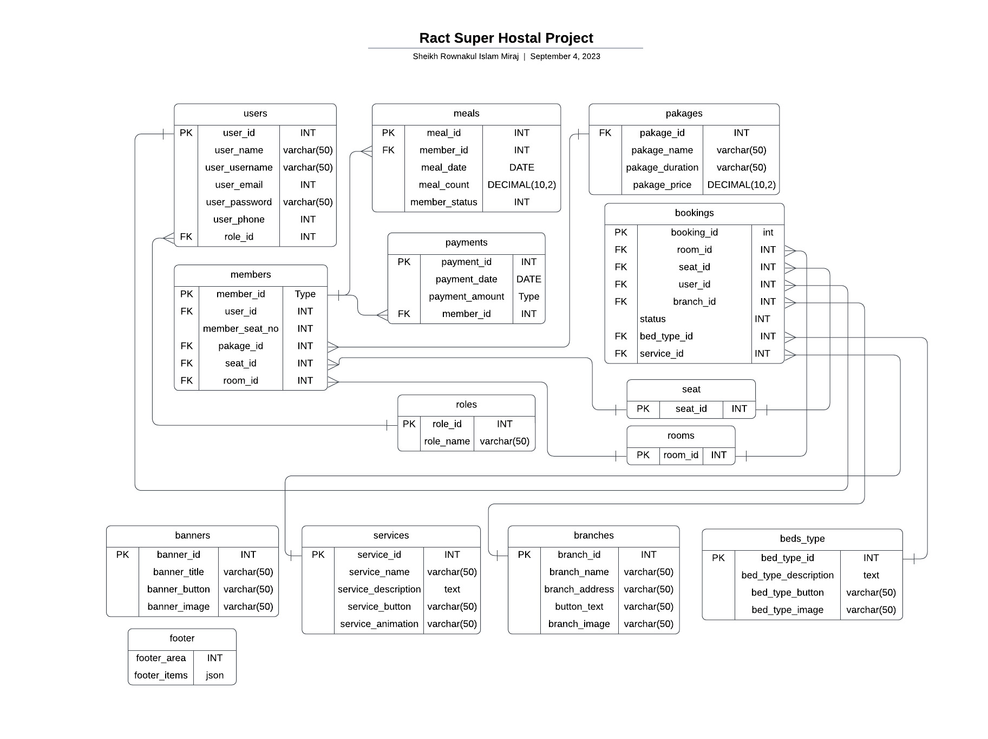
ERD – Entity Relationship Diagram

Slide 10
Software Flowchart
Booking
Processing
Payment
Invoicing

Slide 11
Modules:
Booking
Invoicing
Payment Module
Project
Reports

Slide 12
Timeline And Milestone:
Milestone | Duration (Days)
Requirements Gathering | 2
Design and User Interface | 5
Development and Coding | 15
Testing and Quality Assurance | 5
Deployment and Launch | 2
Project Completion and Handover | 1
Total Duration | 30

Slide 13
Technical Information Source:
Information Source | Description
PHP.net | Official documentation and reference for PHP programming language
MySQL.com | Official documentation and resources for MySQL database management system
W3Schools | Online tutorials and guides for web development technologies, including PHP and MySQL
Stack Overflow | Online community for programmers to ask and answer technical questions
GitHub Repositories | Open-source projects and code repositories for PHP and MySQL

Slide 14
Use of Tools and Technologies:
Tools and Technology | Description | Tools and Technology | Description
PHP | Server-side scripting language used for dynamic web development | jQuery | JavaScript library for simplifying HTML document traversal and manipulation
MySQL | Relational database management system for storing and retrieving data | Git | Version control system for tracking and managing code changes
HTML | Markup language for creating the structure and content of web pages | PhpStorm | Integrated development environment (IDE) for PHP development
CSS | Styling language for enhancing the appearance and layout of web pages | phpMyAdmin | Web-based administration tool for managing MySQL databases
JavaScript | Client-side scripting language for interactive and dynamic web functionality | Bootstrap | CSS framework for creating responsive and mobile-friendly web designs
React | Client side rendering, single page application | React - Router | Routing for single page applicant

Slide 15
Methodology
Agile Development Approach:
We will adopt an Agile development approach to provide flexibility and adaptability throughout the project lifecycle.
Agile emphasizes iterative development, collaboration, and regular feedback to deliver incremental value to stakeholders.
Our team will specifically follow the Scrum framework, which divides the project into sprints and emphasizes frequent communication and collaboration.
Design and Development Phase:
Our team will design the database schema and establish the necessary entity relationships for efficient data management.
We will develop the front-end user interface using PHP, ensuring an intuitive and user-friendly experience.
Back-end functionality, such as hostel management, sales order tracking, and reporting features, will be implemented using PHP and MySQL.
Extensive testing and quality assurance will be performed to ensure the reliability, security, and performance of the software.

Slide 16
Methodology
Collaboration and Communication:
Regular meetings will be scheduled among our team members to review progress, discuss challenges, and make necessary adjustments.
We will actively seek feedback from stakeholders and incorporate it into the development process to ensure their needs are met.
We will utilize project management and collaboration tools, such as task tracking systems and communication platforms, to enhance transparency and efficiency.
Continuous Improvement:
Throughout the project, we will conduct regular retrospectives to identify areas of improvement and implement necessary adjustments.
Feedback from end users and stakeholders will be highly valued and utilized to enhance the software's functionality and user experience.

Slide 17
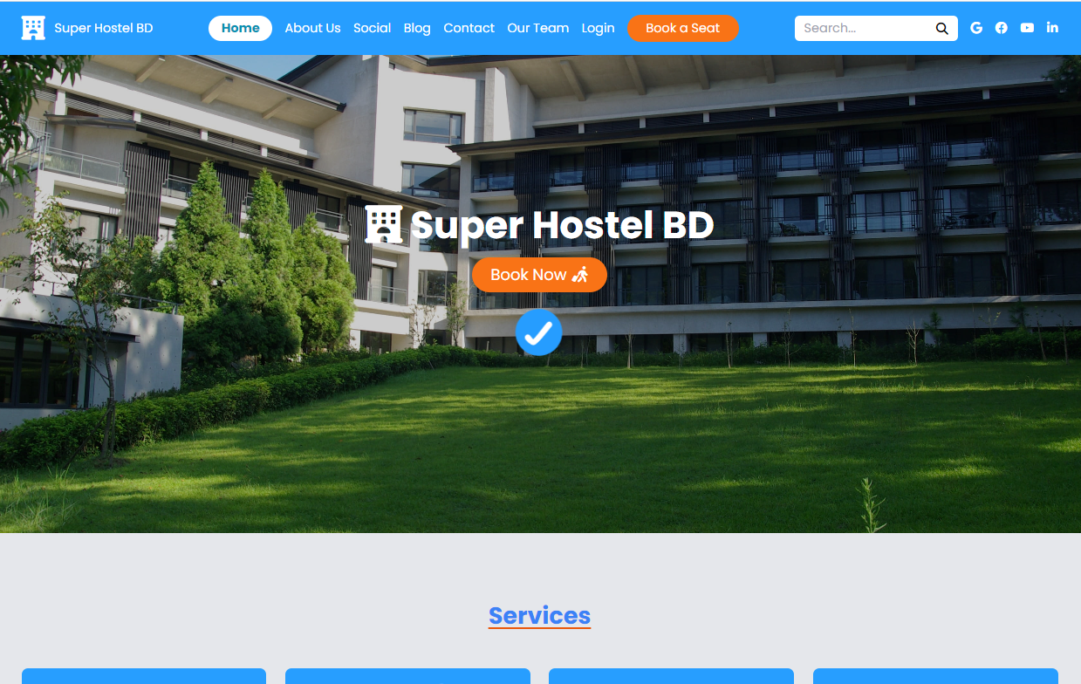
Web Frontend Design

Slide 18
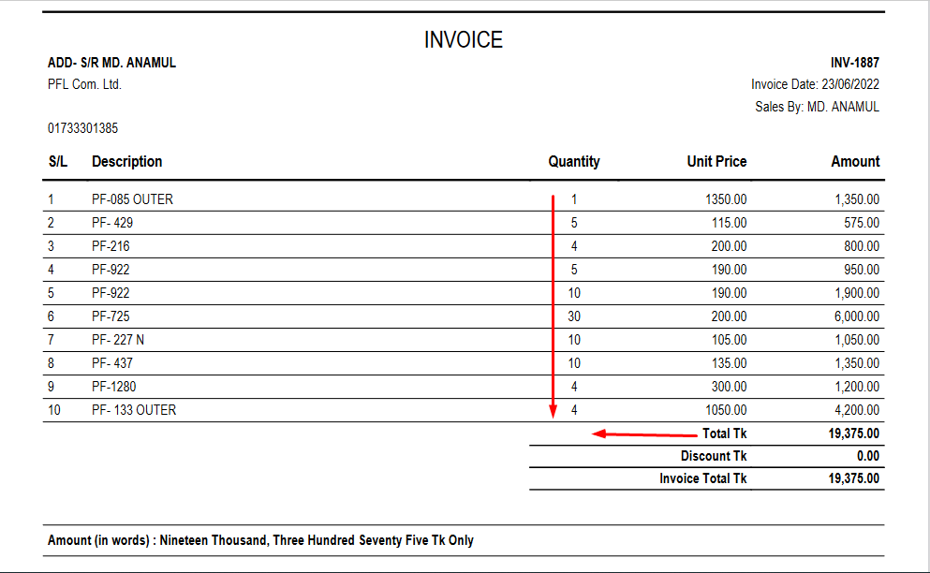
Example of Invoice Report

Slide 19
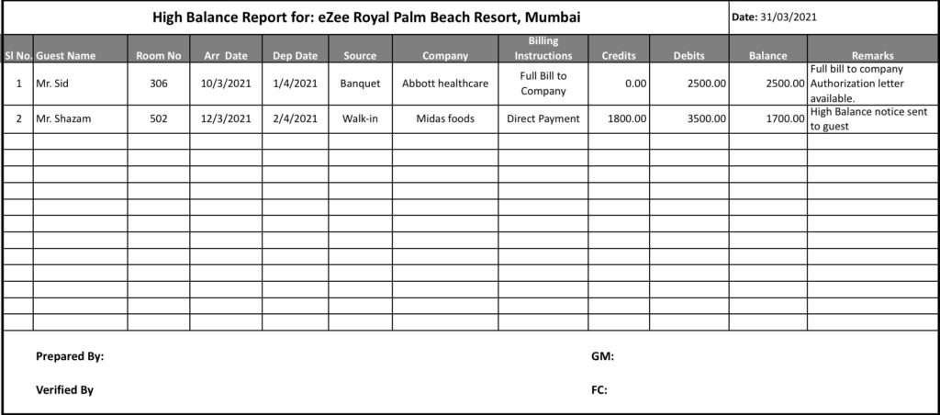
Booking Report Example

Slide 20
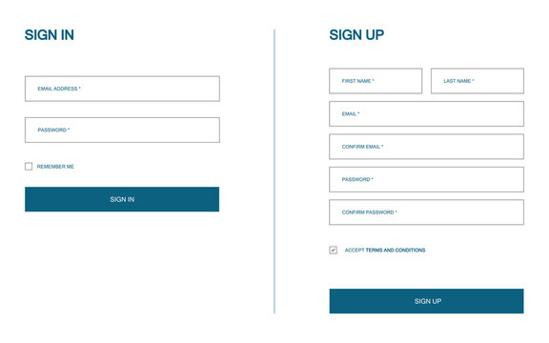
Form Sample

Slide 21
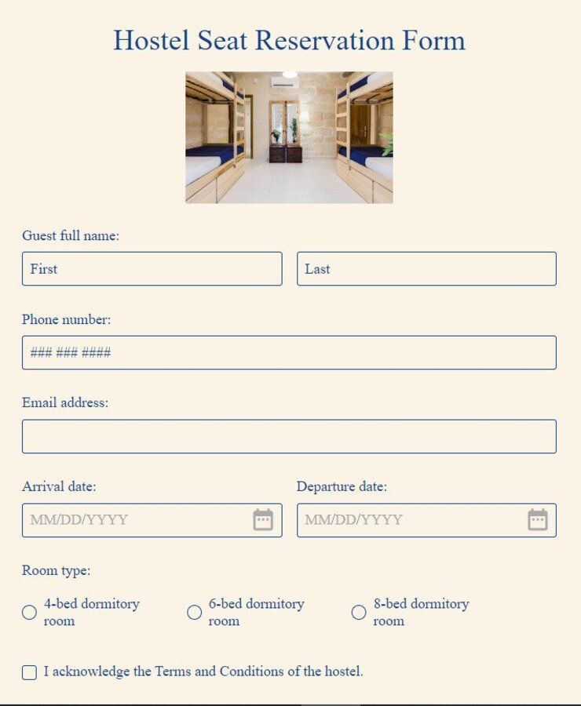
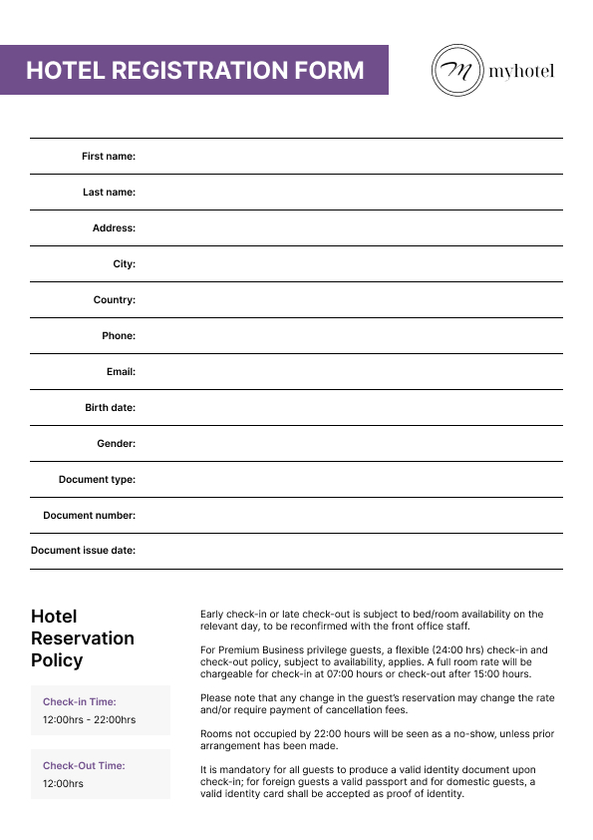
More Form Sample

Slide 22
Conclusion
Our hostel management software proposal offers a comprehensive solution for efficient booking and sales management. With a well-defined Entity-Relationship Diagram (ERD) at its core, the software ensures seamless data organization and retrieval.
The ERD consists of interconnected tables such as “booking," "role," "user," "customer," “rooms," “seat," “frontend," “hotels," “places," and “pakages" These tables facilitate various functionalities, including tracking product quantities, managing user roles, storing customer details, recording booking orders, monitoring sales levels, categorizing buildings, and managing inventory transactions.
In summary, our superhostel management software proposal empowers businesses with efficient operations, optimized booking control, and improved customer satisfaction. It is a valuable tool for businesses of all sizes, aiding in their growth and success.

Slide 23
Thank You

